Slide 1
W4111 – Introduction to Databases Section 002, Spring 2023 Lecture 8: Module II, NoSQL, Document DBs
© Donald F. Ferguson, 2023

Slide 2

Contents
2 | COMS W4111_002_2023_1 - Lecture 8: Module II, NoSQL, Document DBs © Donald F. Ferguson, 2023

Slide 3
Contents

Slide 4
Module II Kickoff
4 | COMS W4111_002_2023_1 - Lecture 8: Module II, NoSQL, Document DBs © Donald F. Ferguson, 2023

Slide 5
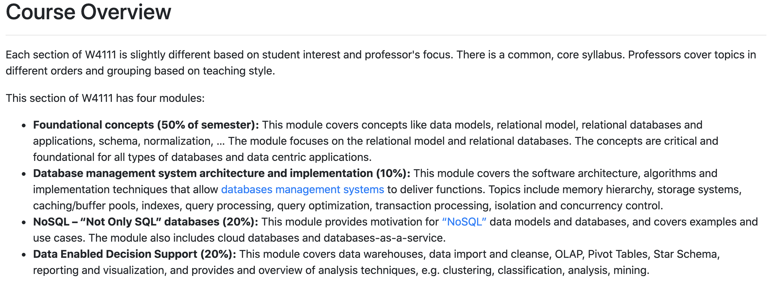
Course Modules – Reminder

Slide 6

Module II – DBMS Architecture and Implementation
Overview and Reminder
6 | COMS W4111_002_2023_1 - Lecture 8: Module II, NoSQL, Document DBs © Donald F. Ferguson, 2023

Slide 7
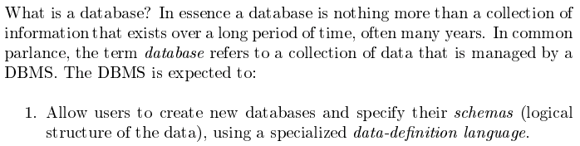
Module II – DBMS Architecture and Implementation
Covered for the relational model.
Database Systems: The Complete Book (2nd Edition) by Hector Garcia-Molina (Author), Jeffrey D. Ullman (Author), Jennifer Widom (Author)

Slide 8
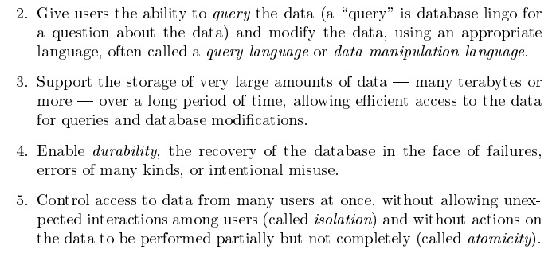
Module II – DBMS Architecture and Implementation
Database Systems: The Complete Book (2nd Edition) by Hector Garcia-Molina (Author), Jeffrey D. Ullman (Author), Jennifer Widom (Author)

Slide 9
Purpose of Database Systems
In the early days, database applications were built directly on top of file systems, which leads to:
Data redundancy and inconsistency: data is stored in multiple file formats resulting in duplication of information in different files
Difficulty in accessing data
Need to write a new program to carry out each new task
Data isolation
Multiple files and formats
Integrity problems
Integrity constraints (e.g., account balance > 0) become “buried” in program code rather than being stated explicitly
Hard to add new constraints or change existing ones
Notes:
9

Slide 10
Purpose of Database Systems (Cont.)
Atomicity of updates
Failures may leave database in an inconsistent state with partial updates carried out
Example: Transfer of funds from one account to another should either complete or not happen at all
Concurrent access by multiple users
Concurrent access needed for performance
Uncontrolled concurrent accesses can lead to inconsistencies
Ex: Two people reading a balance (say 100) and updating it by withdrawing money (say 50 each) at the same time
Security problems
Hard to provide user access to some, but not all, data
Database systems offer solutions to all the above problems. In module I, we explored how users interact with the (some) of the functions through DDL and DML. In module II, we will explore how DBMS implement the capabilities “under the covers.”
In
Notes:
10

Slide 11
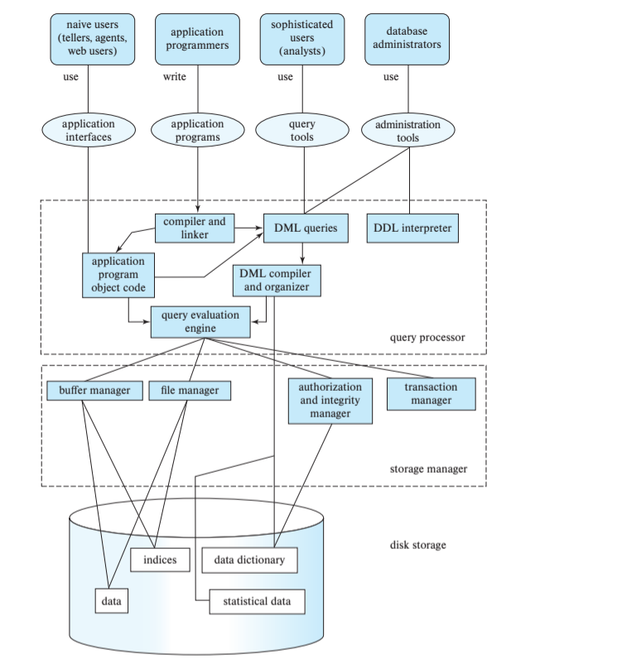
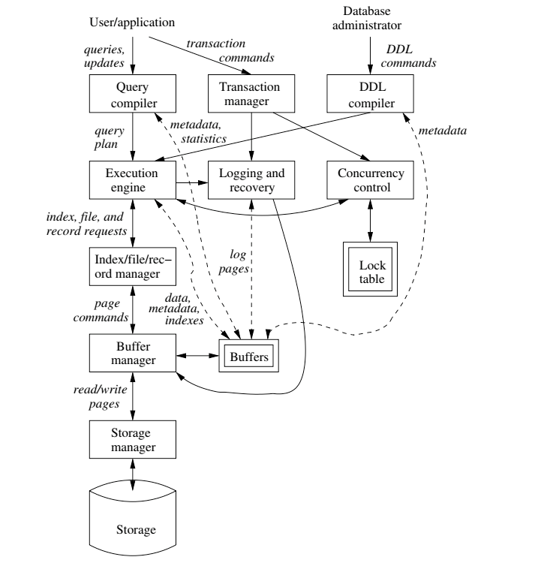
DBMS Arch.

Slide 12

Data Management
Today
Load/save things quickly.
Database Systems: The Complete Book (2nd Edition) by Hector Garcia-Molina (Author), Jeffrey D. Ullman (Author), Jennifer Widom (Author)

Slide 13
Disks Input/Output (IO)
13 | COMS W4111_002_2023_1 - Lecture 8: Module II, NoSQL, Document DBs © Donald F. Ferguson, 2023

Slide 14
Disks as Far as the Eye can See

Slide 15
Classification of Physical Storage Media
Can differentiate storage into:
volatile storage: loses contents when power is switched off
non-volatile storage:
Contents persist even when power is switched off.
Includes secondary and tertiary storage, as well as batter-backed up main-memory.
Factors affecting choice of storage media include
Speed with which data can be accessed
Cost per unit of data
Reliability
From: Database System Concepts, 7th Ed.

Slide 16
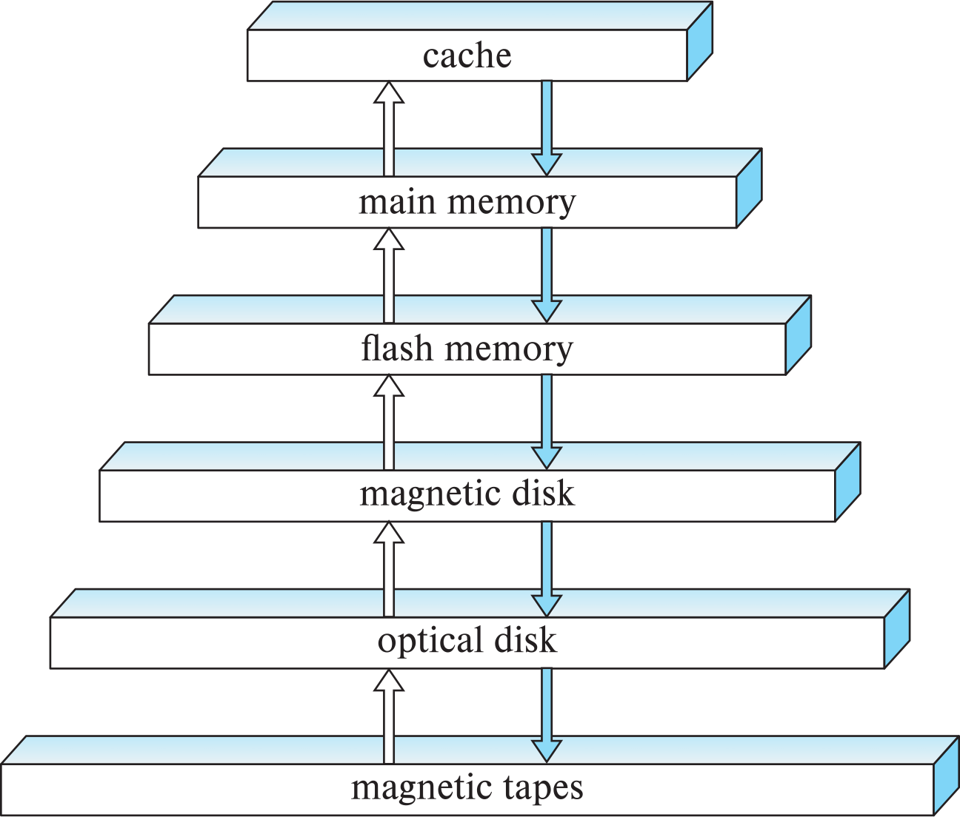
Storage Hierarchy
CPU
From: Database System Concepts, 7th Ed.

Slide 17
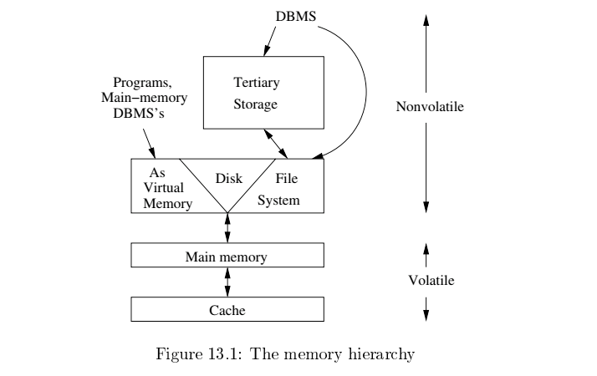
Memory Hierarchy
Slower
Cheaper
Unlimited
Faster
More expensive
Limited
From: Database System Concepts, 7th Ed.

Slide 18
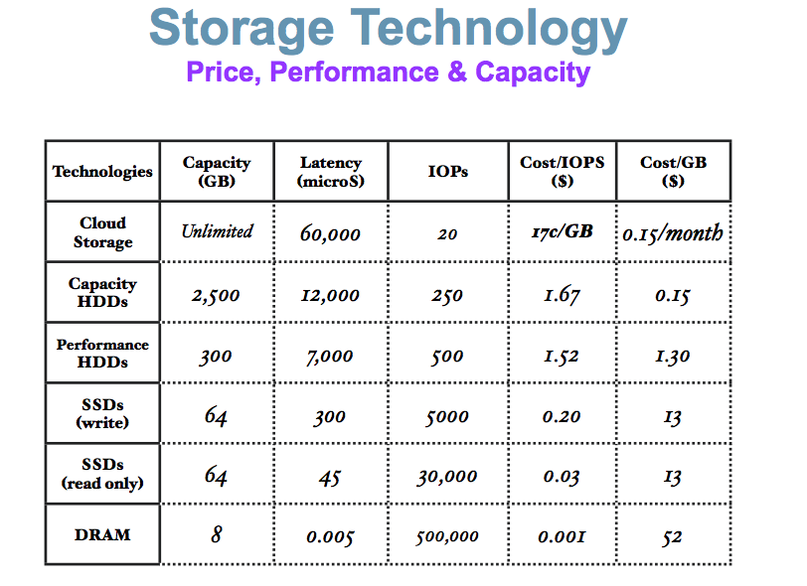
Memory Hierarchy (Very Old Numbers – Still Directionally Valid)
These numbers are ancient.
Looking for more modern numbers.
But, does give an idea of
Price
Performance
The general observation is that
Performance goes up 10X/level.
Price goes up 10x per level.
Note: One major change is improved price performance of SDD relative to HDD for large data.

Slide 19
Storage Hierarchy (Cont.)
primary storage: Fastest media but volatile (cache, main memory).
secondary storage: next level in hierarchy, non-volatile, moderately fast access time
Also called on-line storage
E.g., flash memory, magnetic disks
tertiary storage: lowest level in hierarchy, non-volatile, slow access time
also called off-line storage and used for archival storage
e.g., magnetic tape, optical storage
Magnetic tape
Sequential access, 1 to 12 TB capacity
A few drives with many tapes
Juke boxes with petabytes (1000’s of TB) of storage
From: Database System Concepts, 7th Ed.

Slide 20
Hard Disk Drive

Slide 21
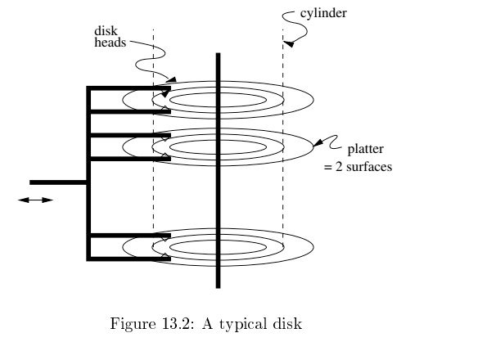
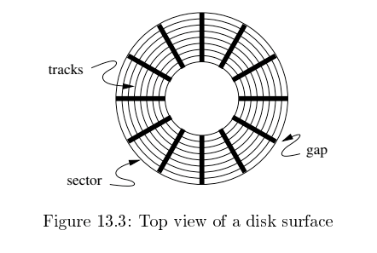
Disk Configuration
Components of disk I/O delay
Seek: Move head to cylinder/track.
Rotation: Wait for sector to get under head.
Transfer: Move data from disk to memory.
Database Systems: The Complete Book (2nd Edition) by Hector Garcia-Molina (Author), Jeffrey D. Ullman (Author), Jennifer Widom (Author)

Slide 22
Hard Disk versus Solid State Disk
Hard
Disk
Drive
Solid
State
Drive

Slide 23
Flash Storage
NOR flash vs NAND flash
NAND flash
used widely for storage, cheaper than NOR flash
requires page-at-a-time read (page: 512 bytes to 4 KB)
20 to 100 microseconds for a page read
Not much difference between sequential and random read
Page can only be written once
Must be erased to allow rewrite
Solid state disks
Use standard block-oriented disk interfaces, but store data on multiple flash storage devices internally
Transfer rate of up to 500 MB/sec using SATA, and up to 3 GB/sec using NVMe PCIe
From: Database System Concepts, 7th Ed.
Despite the radically different implementation, it has a disk oriented API.

Slide 24
Logical Block Addressing
Concept:
The unit of transfer from a “disk” to the computers memory is a “block. Blocks are usually relatively large, e.g. 16 KB, 32 KB, ... ...
A program that reads or write a single byte, requires the database engine (or file system) to read/write the entire block.
The address of a block in the entire space of blocks is:
(Device ID, Block ID)
Block ID is simple 0, 1, 2, ... ...
The disk controller and disk implementation translate the logical block address into the physical address of blocks.
The physical address changes over time for various reasons, e.g. performance optimization, internal HW failure, etc.

Slide 25
Logical/Physical Block Addressing
The mapping from LBA to physical block address can change over time.
Internal HW failure.
SSD writes in a funny way.
You have to erase before writing.
So, the SSD (for performance)
Writes to an empty block.
Erase the original block.
Performance optimization on HDD
Based on block access patterns.
Place blocks on cylinder/sector/head in a way to minimize:
Seek
Rotate
Read/Write N
Processor
Read/Write N
Mech Controller
Buffer

Slide 26
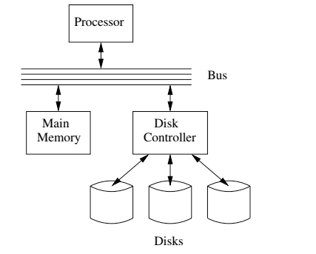
I/O Architecture
Large scale environments
The bus-controller connection is over some kind of network.
The disk controller is at the disks, and basically a “computer” with SW.
Network is either
Standard communication network, or
Highly optimized I/O network.
How we normally think of disks and I/O.

Slide 27
Magnetic Disks
Read-write head
Surface of platter divided into circular tracks
Over 50K-100K tracks per platter on typical hard disks
Each track is divided into sectors.
A sector is the smallest unit of data that can be read or written.
Sector size typically 512 bytes
Typical sectors per track: 500 to 1000 (on inner tracks) to 1000 to 2000 (on outer tracks)
To read/write a sector
disk arm swings to position head on right track
platter spins continually; data is read/written as sector passes under head
Head-disk assemblies
multiple disk platters on a single spindle (1 to 5 usually)
one head per platter, mounted on a common arm.
Cylinder i consists of i^{th} track of all the platters
From: Database System Concepts, 7th Ed.
Notes:
Mention: checksums, bad sector remapping

Slide 28
Magnetic Disks (Cont.)
Disk controller – interfaces between the computer system and the disk drive hardware.
accepts high-level commands to read or write a sector
initiates actions such as moving the disk arm to the right track and actually reading or writing the data
Computes and attaches checksums to each sector to verify that data is read back correctly
If data is corrupted, with very high probability stored checksum won’t match recomputed checksum
Ensures successful writing by reading back sector after writing it
Performs remapping of bad sectors
From: Database System Concepts, 7th Ed.

Slide 29
Performance Measures of Disks
Access time – the time it takes from when a read or write request is issued to when data transfer begins. Consists of:
Seek time – time it takes to reposition the arm over the correct track.
Average seek time is 1/2 the worst case seek time.
Would be 1/3 if all tracks had the same number of sectors, and we ignore the time to start and stop arm movement
4 to 10 milliseconds on typical disks
Rotational latency – time it takes for the sector to be accessed to appear under the head.
4 to 11 milliseconds on typical disks (5400 to 15000 r.p.m.)
Average latency is 1/2 of the above latency.
Overall latency is 5 to 20 msec depending on disk model
Data-transfer rate – the rate at which data can be retrieved from or stored to the disk.
25 to 200 MB per second max rate, lower for inner tracks
From: Database System Concepts, 7th Ed.

Slide 30
Performance Measures (Cont.)
Disk block is a logical unit for storage allocation and retrieval
4 to 16 kilobytes typically
Smaller blocks: more transfers from disk
Larger blocks: more space wasted due to partially filled blocks
Sequential access pattern
Successive requests are for successive disk blocks
Disk seek required only for first block
Random access pattern
Successive requests are for blocks that can be anywhere on disk
Each access requires a seek
Transfer rates are low since a lot of time is wasted in seeks
I/O operations per second (IOPS)
Number of random block reads that a disk can support per second
50 to 200 IOPS on current generation magnetic disks
From: Database System Concepts, 7th Ed.

Slide 31
Performance Measures (Cont.)
Mean time to failure (MTTF) – the average time the disk is expected to run continuously without any failure.
Typically 3 to 5 years
Probability of failure of new disks is quite low, corresponding to a “theoretical MTTF” of 500,000 to 1,200,000 hours for a new disk
E.g., an MTTF of 1,200,000 hours for a new disk means that given 1000 relatively new disks, on an average one will fail every 1200 hours
MTTF decreases as disk ages
From: Database System Concepts, 7th Ed.

Slide 32
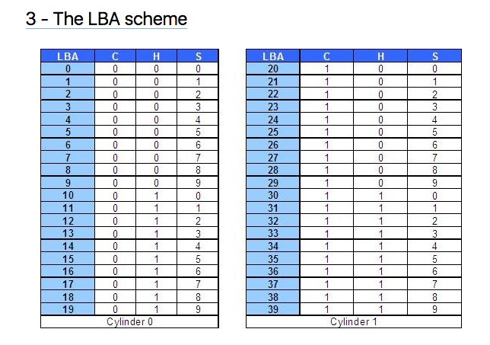
Logical Block Addressing (https://gerardnico.com/wiki/data_storage/lba)
CHS addresses can be converted to LBA addresses using the following formula:
LBA = (( C x HPC ) + H ) x SPT + S – 1
where,
C, H and S are the cylinder number, the head number, and the sector number
LBA is the logical block address
HPC is the number of heads per cylinder
SPT is the number of sectors per track
Devices have configuration and metadata APIs that allow storage manager to
Map between LBA and CHS
To optimize block placement
Based on access patterns, statistics, data schema, etc.

Slide 33
I/O Architecture
Redundant Array of Independent Disks (RAID)

Slide 34
RAID (https://en.wikipedia.org/wiki/RAID)
“RAID (redundant array of independent disks) is a data storage virtualization technology that combines multiple physical disk drive components into a single logical unit for the purposes of data redundancy, performance improvement, or both. (…)
RAID 0 consists of striping, without mirroring or parity. (…)
RAID 1 consists of data mirroring, without parity or striping. (…)
RAID 2 consists of bit-level striping with dedicated Hamming-code parity. (…)
RAID 3 consists of byte-level striping with dedicated parity. (…)
RAID 4 consists of block-level striping with dedicated parity. (…)
RAID 5 consists of block-level striping with distributed parity. (…)
RAID 6 consists of block-level striping with double distributed parity. (…)
Nested RAID
RAID 0+1: creates two stripes and mirrors them. (…)
RAID 1+0: creates a striped set from a series of mirrored drives. (…)
JBOD RAID N+N: With JBOD (just a bunch of disks), (…)”

Slide 35
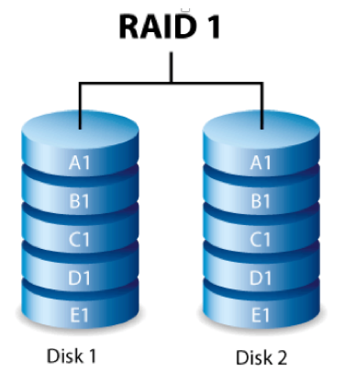
RAID-0 and RAID-1
Two physical disks make one single, logical fast disk
Two physical disks make one single, logical reliable disk
Single “Fast” Disk
Single “Reliable” Disk

Slide 36
Mixed RAID Modes
Stripe
And
Mirror

Slide 37
RAID-5
One Big Logical Disk
Improved performance through parallelism
Rotation/seek
Transfer
Availability uses parity blocks
Suppose I have 4 different data blocks on the logical drive A: A1, A2, A3, A4.
Parity function: Ap = P(A1,A2,A3,A4)
Recovery function: A2=R(Ap,A1,A3,A4)
During normal operations:
Read processing simply retrieves block.
Write processing of A2 updates A2 and Ap
If an individual disk fails, the RAID
Read
Continues to function for reads on non-missing blocks.
Implements read on missing block by recalculating value.
Write
Updates block and parity block for non-missing blocks.
Computes missing block, and calculates parity based on old and new value.
Over time
“Hot Swap” the failed disk.
Rebuild the missing data from values and parity.
Is actually 5 smaller “logical” disks.
A
B
C
D
E
Logical disk data spread over 5 physical disks.

Slide 38
Very Simple Parity Example
Even-Odd Parity
b[i] is an array of bits (0 or 1)
P(b[i]) =
0 is an even number of bits = 1. {P([0,1,1,0,1,1])= 0
1 if an odd number of bits = 1. {P(0,0,1,0,1,1]= 1
Given an array with one missing bit and the parity bit, I can re-compute the missing bit.
Case 1: [0,?,1,0,1,1] has P=0. There must be an EVEN number of ones and ?=1.
Case 2: [0,?,1,0,1,1] has P=1. There must be an ODD number of ones and ?=0.
Block Parity applies this to a set of blocks bitwise
A1=[0,1,0,0,1,1]
A2=[1,1,1,0,0,0]
A3=[0,0,0,1,0,1]
Pa=[1,0,1,1,1,0]
➔
If I am missing a block and have the parity block, I can re-compute the missing block bitwise from remaining blocks and parity block.

Slide 39
Data Storage Structures (Database Systems Concepts, V7, Ch. 13)
39 | COMS W4111_002_2023_1 - Lecture 8: Module II, NoSQL, Document DBs © Donald F. Ferguson, 2023

Slide 40
File Organization
The database is stored as a collection of files. Each file is a sequence of records. A record is a sequence of fields.
One approach
Assume record size is fixed
Each file has records of one particular type only
Different files are used for different relations
This case is easiest to implement; will consider variable length records later
We assume that records are smaller than a disk block
.
From: Database System Concepts, 7th Ed.

Slide 41
Terminology
A tuple in a relation maps to a record. Records may be
Fixed length
Variable length
Variable format (which we will see in Neo4J, DynamoDB, etc).
A block
Is the unit of transfer between disks and memory (buffer pools).
Contains multiple records, usually but not always from the same relation.
The database address space contains
All of the blocks and records that the database manages
Including blocks/records containing data
And blocks/records containing free space.

Slide 42
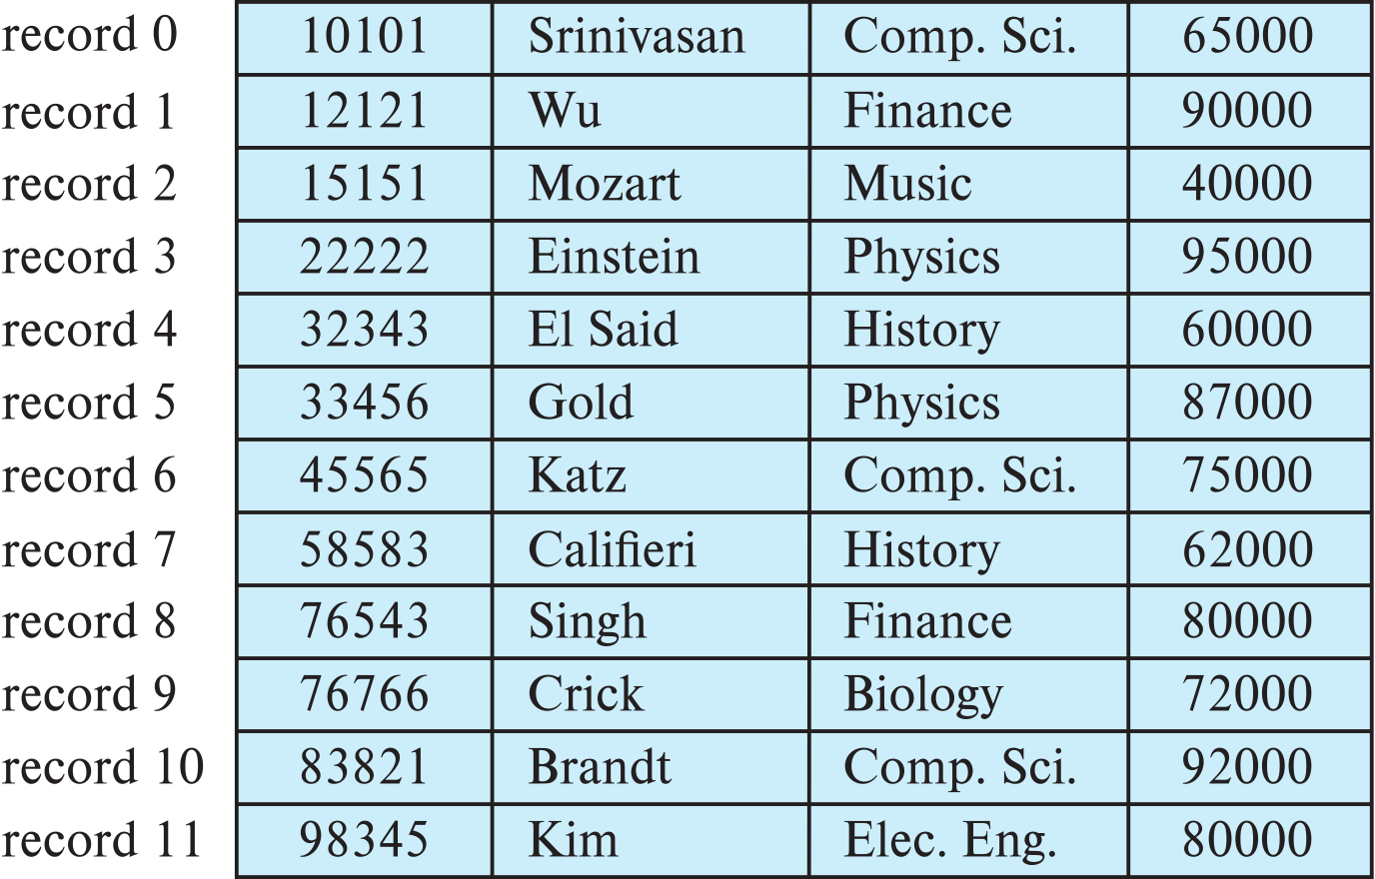
Fixed-Length Records
Simple approach:
Store record i starting from byte n ∗ (i – 1), where n is the size of each record.
Record access is simple but records may cross blocks
Modification: do not allow records to cross block boundaries
From: Database System Concepts, 7th Ed.

Slide 43
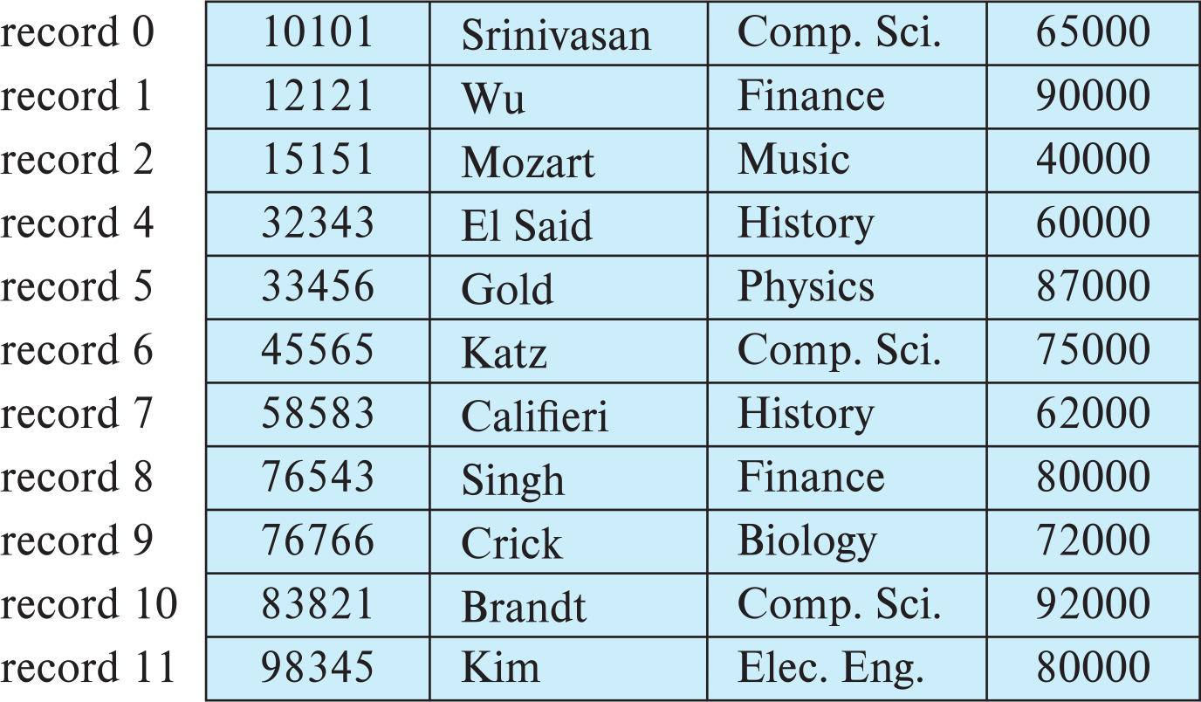
Fixed-Length Records
Deletion of record i: alternatives:
move records i + 1, . . ., n to i, . . . , n – 1
move record n to i
do not move records, but link all free records on a free list
Record 3 deleted
From: Database System Concepts, 7th Ed.

Slide 44
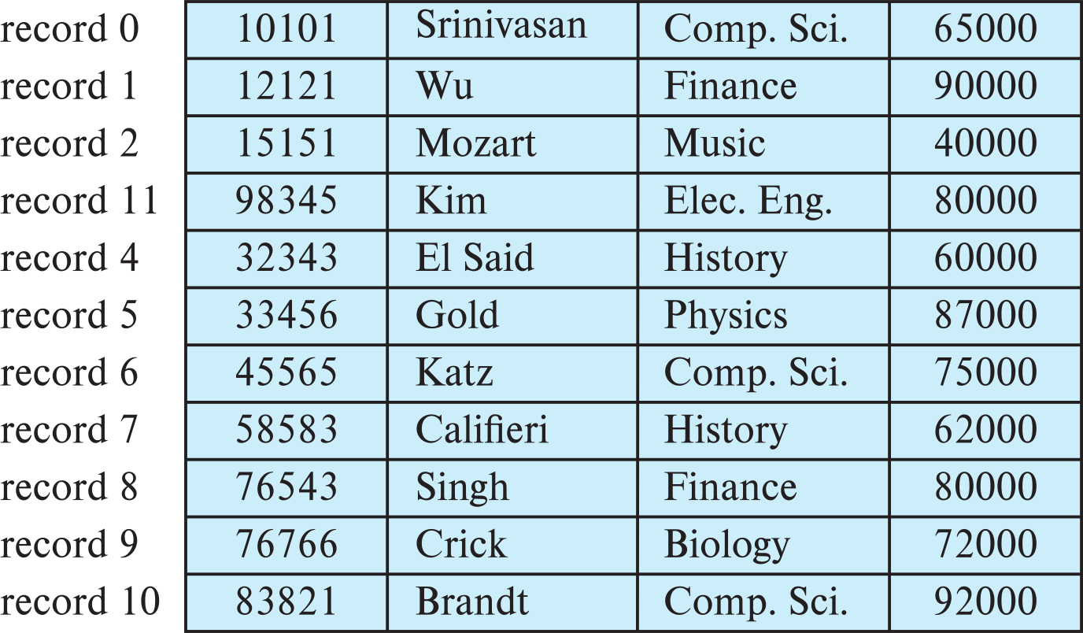
Fixed-Length Records
Deletion of record i: alternatives:
move records i + 1, . . ., n to i, . . . , n – 1
move record n to i
do not move records, but link all free records on a free list
Record 3 deleted and replaced by record 11
From: Database System Concepts, 7th Ed.

Slide 45
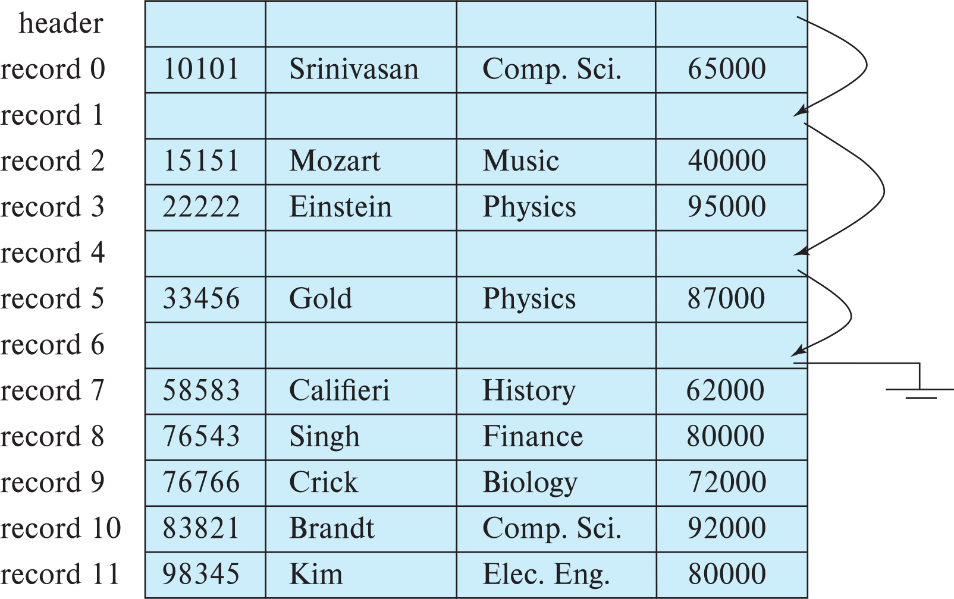
Fixed-Length Records
Deletion of record i: alternatives:
move records i + 1, . . ., n to i, . . . , n – 1
move record n to i
do not move records, but link all free records on a free list
From: Database System Concepts, 7th Ed.

Slide 46
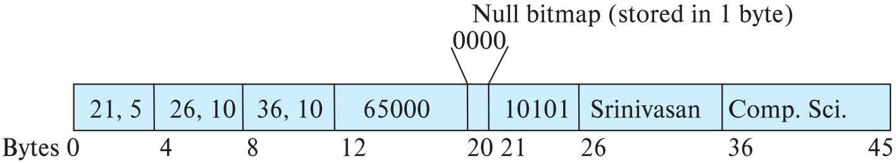
Variable-Length Records
Variable-length records arise in database systems in several ways:
Storage of multiple record types in a file.
Record types that allow variable lengths for one or more fields such as strings (varchar)
Record types that allow repeating fields (used in some older data models).
Attributes are stored in order
Variable length attributes represented by fixed size (offset, length), with actual data stored after all fixed length attributes
Null values represented by null-value bitmap
From: Database System Concepts, 7th Ed.

Slide 47
Variable-Length Records: Slotted Page Structure
Slotted page header contains:
number of record entries
end of free space in the block
location and size of each record
Records can be moved around within a page to keep them contiguous with no empty space between them; entry in the header must be updated.
Pointers should not point directly to record — instead they should point to the entry for the record in header.
From: Database System Concepts, 7th Ed.

Slide 48
Storing Large Objects
E.g., blob/clob types
Records must be smaller than pages
Alternatives:
Store as files in file systems
Store as files managed by database
Break into pieces and store in multiple tuples in separate relation
PostgreSQL TOAST
From: Database System Concepts, 7th Ed.

Slide 49
Organization of Records in Files
Heap – record can be placed anywhere in the file where there is space
Sequential – store records in sequential order, based on the value of the search key of each record
In a multitable clustering file organization records of several different relations can be stored in the same file
Motivation: store related records on the same block to minimize I/O
B⁺-tree file organization
Ordered storage even with inserts/deletes
More on this in Chapter 14
Hashing – a hash function computed on search key; the result specifies in which block of the file the record should be placed
More on this in Chapter 14
From: Database System Concepts, 7th Ed.

Slide 50
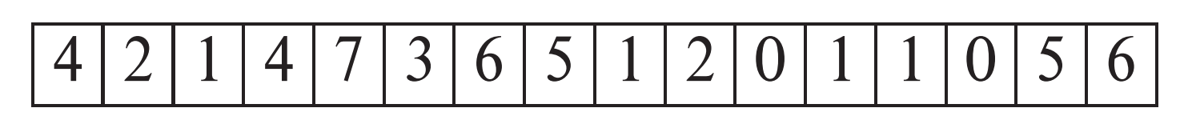
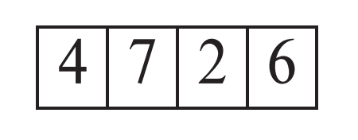
Heap File Organization
Records can be placed anywhere in the file where there is free space
Records usually do not move once allocated
Important to be able to efficiently find free space within file
Free-space map
Array with 1 entry per block. Each entry is a few bits to a byte, and records fraction of block that is free
In example below, 3 bits per block, value divided by 8 indicates fraction of block that is free
Can have second-level free-space map
In example below, each entry stores maximum from 4 entries of first-level free-space map
Free space map written to disk periodically, OK to have wrong (old) values for some entries (will be detected and fixed)
From: Database System Concepts, 7th Ed.

Slide 51
Sequential File Organization
Suitable for applications that require sequential processing of the entire file
The records in the file are ordered by a search-key
From: Database System Concepts, 7th Ed.

Slide 52
Sequential File Organization (Cont.)
Deletion – use pointer chains
Insertion –locate the position where the record is to be inserted
if there is free space insert there
if no free space, insert the record in an overflow block
In either case, pointer chain must be updated
Need to reorganize the file from time to time to restore sequential order
From: Database System Concepts, 7th Ed.

Slide 53
Partitioning
Table partitioning: Records in a relation can be partitioned into smaller relations that are stored separately
E.g., transaction relation may be partitioned into transaction_2018, transaction_2019, etc.
Queries written on transaction must access records in all partitions
Unless query has a selection such as year=2019, in which case only one partition in needed
Partitioning
Reduces costs of some operations such as free space management
Allows different partitions to be stored on different storage devices
E.g., transaction partition for current year on SSD, for older years on magnetic disk

Slide 54
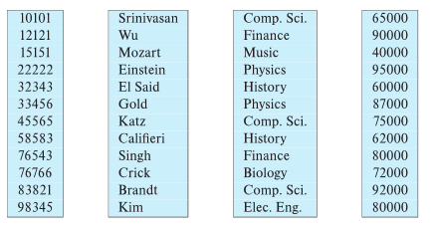
Column-Oriented Storage
Also known as columnar representation
Store each attribute of a relation separately
Example
From: Database System Concepts, 7th Ed.

Slide 55
Columnar Representation
Benefits:
Reduced IO if only some attributes are accessed
Improved CPU cache performance
Improved compression
Vector processing on modern CPU architectures
Drawbacks
Cost of tuple reconstruction from columnar representation
Cost of tuple deletion and update
Cost of decompression
Columnar representation found to be more efficient for decision support than row-oriented representation
Traditional row-oriented representation preferable for transaction processing
Some databases support both representations
Called hybrid row/column stores
From: Database System Concepts, 7th Ed.

Slide 56
Row vs Column
Columnar and Row are both
Relational
Support SQL operations
But differ in data storage
Row keeps row data together in blocks.
Columnar keys column data together in blocks.
This determines performance for different types of query, e.g.
Columnar is extremely powerful for BI scenarios
Aggregation ops, e.g. SUM, AVG
PROJECT (do not load all of the row) to get a few columns
Row is powerful for OLTP. Transaction typically create and retrieve
One row at a time
All the columns of a single row.

Slide 57
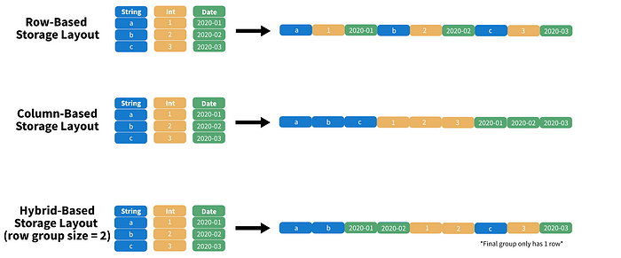
Columnar File Representation
https://towardsdatascience.com/demystifying-the-parquet-file-format-13adb0206705
Apache parquet is an open-source file format that provides efficient storage and fast read speed. It uses a hybrid storage format which sequentially stores chunks of columns, lending to high performance when selecting and filtering data. On top of strong compression algorithm support (snappy, gzip, LZO), it also provides some clever tricks for reducing file scans and encoding repeat variables.

Slide 58
NoSQL
58 |Introduction to Databases (S22): Lecture 9: NoSQL (I), Module II (I) © Donald F. Ferguson, 2022

Slide 59
Concepts
59 | COMS W4111_002_2023_1 - Lecture 8: Module II, NoSQL, Document DBs © Donald F. Ferguson, 2023

Slide 60
Overview (I) (https://en.wikipedia.org/wiki/NoSQL)
A NoSQL (originally referring to "non SQL" or "non relational")^{[1]} database provides a mechanism for storage and retrieval of data that is modeled in means other than the tabular relations used in relational databases. Such databases have existed since the late 1960s, but did not obtain the "NoSQL" moniker until a surge of popularity in the early twenty-first century,^{[2]} triggered by the needs of Web 2.0 companies such as Facebook, Google, and Amazon.com.^{[3][4][5]} NoSQL databases are increasingly used in big data and real-time web applications.^{[6]} NoSQL systems are also sometimes called "Not only SQL" to emphasize that they may support SQL-like query languages.^{[7][8]}
Motivations for this approach include: simplicity of design, simpler "horizontal" scaling to clusters of machines (which is a problem for relational databases),^{[2]} and finer control over availability. The data structures used by NoSQL databases (e.g. key-value, wide column, graph, or document) are different from those used by default in relational databases, making some operations faster in NoSQL. The particular suitability of a given NoSQL database depends on the problem it must solve. Sometimes the data structures used by NoSQL databases are also viewed as "more flexible" than relational database tables.^{[9]}

Slide 61
Overview (I) (https://en.wikipedia.org/wiki/NoSQL)
Many NoSQL stores compromise consistency (in the sense of the CAP theorem) in favor of availability, partition tolerance, and speed. Barriers to the greater adoption of NoSQL stores include the use of low-level query languages (instead of SQL, for instance the lack of ability to perform ad-hoc joins across tables), lack of standardized interfaces, and huge previous investments in existing relational databases.^{[10]} Most NoSQL stores lack true ACID transactions, … …
Instead, most NoSQL databases offer a concept of "eventual consistency" in which database changes are propagated to all nodes "eventually" (typically within milliseconds) so queries for data might not return updated data immediately or might result in reading data that is not accurate, a problem known as stale reads.^{[11]} Additionally, some NoSQL systems may exhibit lost writes and other forms of data loss.^{[12]} Fortunately, some NoSQL systems provide concepts such as write-ahead logging to avoid data loss.^{[13]} For distributed transaction processing across multiple databases, data consistency is an even bigger challenge that is difficult for both NoSQL and relational databases. Even current relational databases "do not allow referential integrity constraints to span databases."^{[14]}

Slide 62
Simplistic Classification (https://medium.com/swlh/4-types-of-nosql-databases-d88ad21f7d3b)
Relational is the foundational model.
We will see OLAP in a future lecture.
Subject of this lecture and part of HW4
We covered graphs and examples.

Slide 63
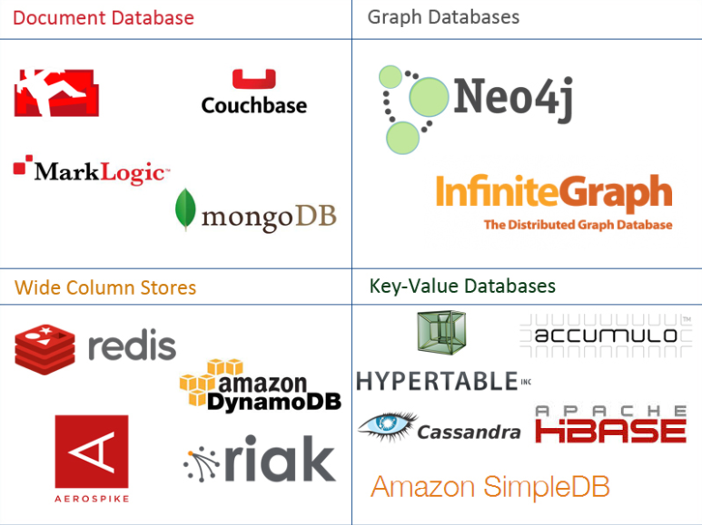
One Taxonomy

Slide 64
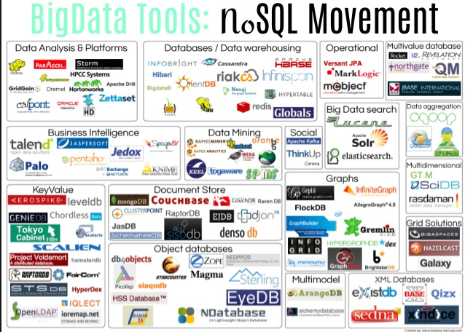
Another Taxonomy

Slide 65
Use Cases
Motivations
Massive write performance.
Fast key value look ups.
Flexible schema and data types.
No single point of failure.
Fast prototyping and development.
Out of the box scalability.
Easy maintenance.
What is wrong with SQL/Relational?
Nothing. One size fits all? Not really.
Impedance mismatch. – Object Relational Mapping doesn’t work quite well.
Rigid schema design.
Harder to scale.
Replication.
Joins across multiple nodes? Hard.
How does RDMS handle data growth? Hard.
Need for a DBA.
Many programmers are already familiar with it.
Transactions and ACID make development easy.
Lots of tools to use.

Slide 66
Documents
66 | COMS W4111_002_2023_1 - Lecture 8: Module II, NoSQL, Document DBs © Donald F. Ferguson, 2023

Slide 67
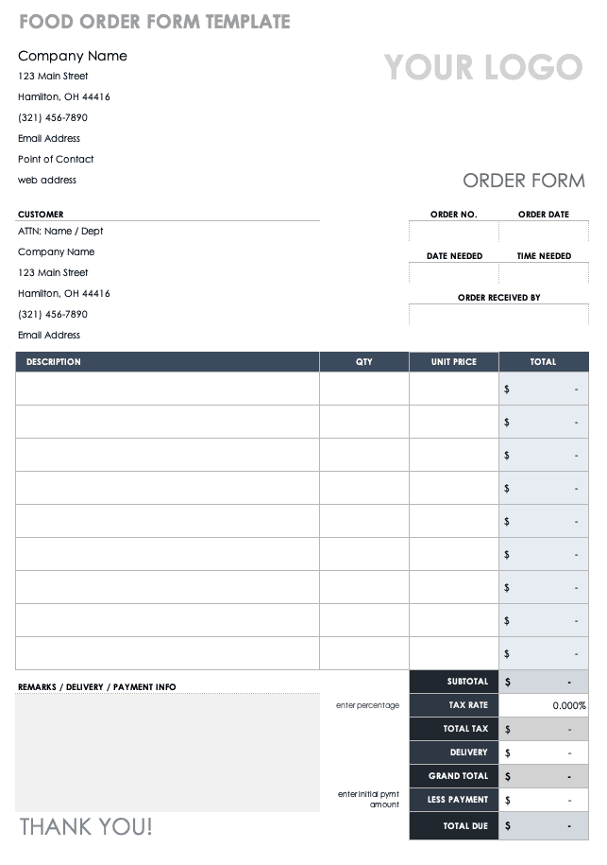
Example Document – An Order
There are 5 entity types on the form:
A “copy of” customer information.
Links (via productCode) to products
Order
OrderDetails
Comments
But OrderDetails and Comments are somehow different from the others.
These are arrays of objects
That are sort of “inside” the order.
These are weak entities, but relational does not always handle these well.

Slide 68
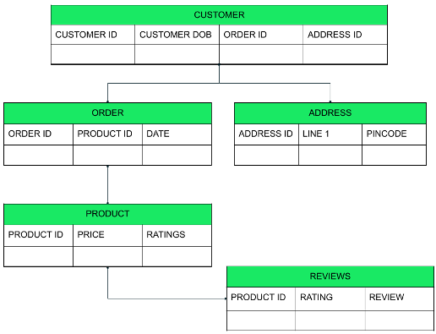
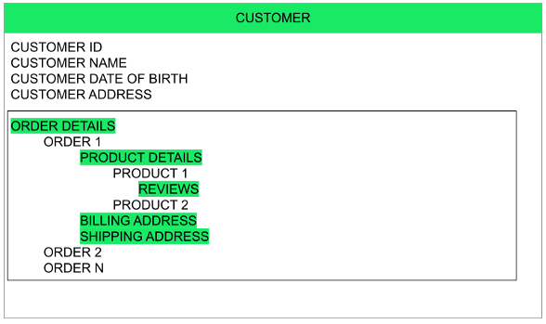
Relational vs Document
Relational
Relational
The key difference?
Relational DB attributes are atomic.
Document DB attributes may be multi-valued and complex.

Slide 69
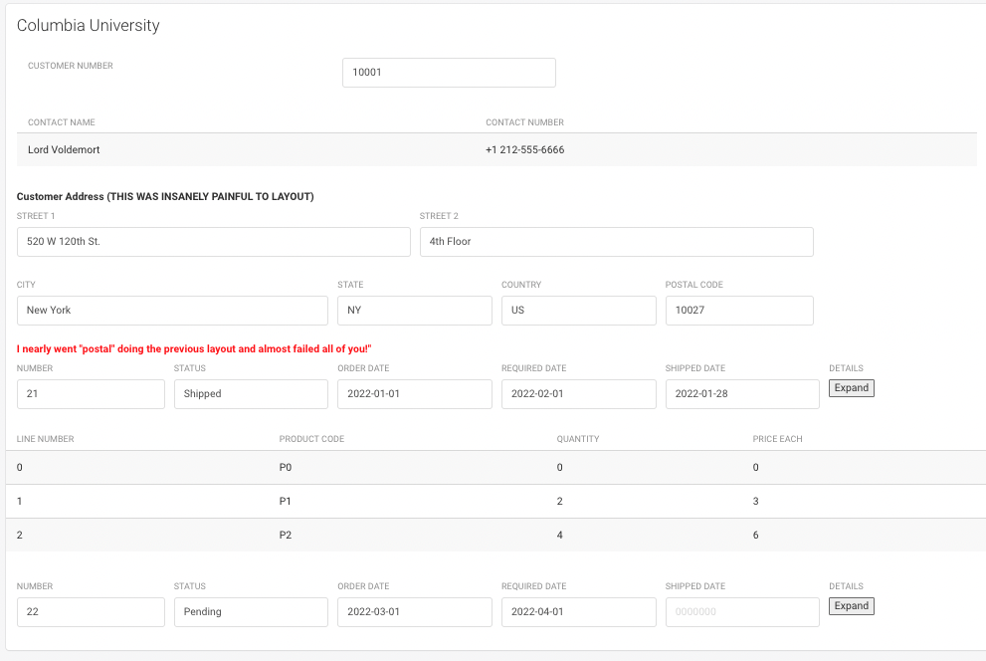
UI Interface and Logical Data Model
{
customerName: “Columbia University”,
contact: {
name: “Lord Voldemort”,
phone: “+1 212-555-6666”
},
address: {
line1: “520 W 120th St.”
line2: “Floor 4”,
… …
}
orders: [
{
number: …,
… …
details: [
… …
]
}
]
}

Slide 70
Switch to Notebook

Slide 71
MongoDB
71 | COMS W4111_002_2023_1 - Lecture 8: Module II, NoSQL, Document DBs © Donald F. Ferguson, 2023

Slide 72
MongoDB Concepts
RDBMS | MongoDB | MongoDB
Database | Database | Database
Table | Collection | Collection
Tuple/Row | Document | Document
column | Field | Field
Table Join | Embedded Documents | Embedded Documents
Primary Key | Primary Key (Default key _id provided by MongoDB itself) | Primary Key (Default key _id provided by MongoDB itself)
Database Server, Client, Tools, Packages
mysqld/Oracle |  | mongod
mysql/sqlplus |  | mongo
DataGrip |  | Compass
pymysql |  | pymongo

Slide 73
Core Operations
Basic Operations:
Create database
Create collection
Create-Retrieve-Update-Delete (CRUD):
Create: insert()
Retrieve:
find()
find_one()
Update: update()
Delete: remove()
More Advanced Concepts:
Limit
Sort
Aggregation Pipelines
Merge
Union
Lookup
Match
Merge
Sample
... ...
We will just cover the basics for now and may cover more things in HW or other lectures.

Slide 74
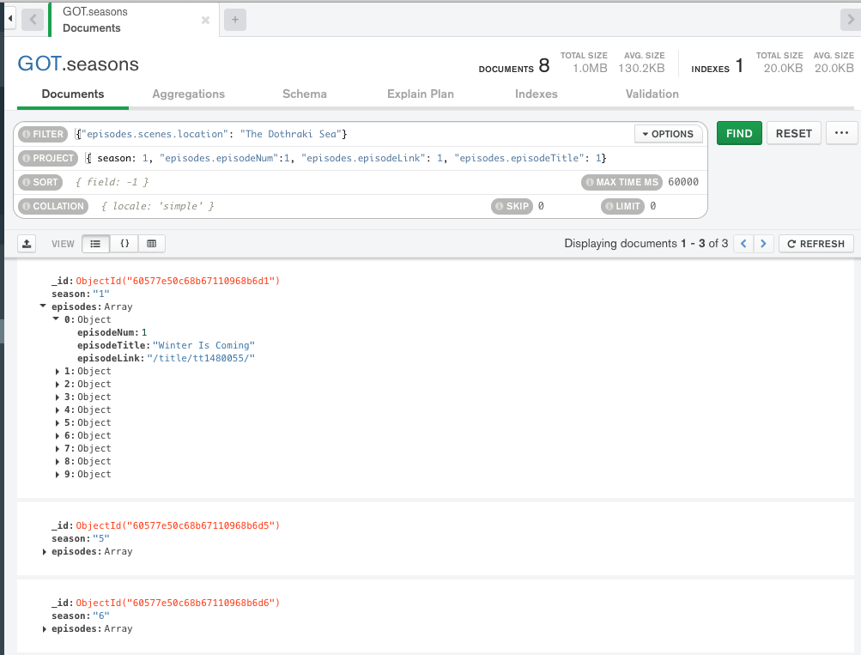
find()
Note:
MongoDB uses a more pymysql approach, e.g. an API, than pure declarative languages like SQL.
The parameters for find() are where the declarative language appears.
The basic forms of find() and find_one() have two parameters:
filter expression
Project expression
You can use the Compass tool and screen captures for some HW and exam answers.
What if I want the answer in a Jupyter Notebook?

Slide 75
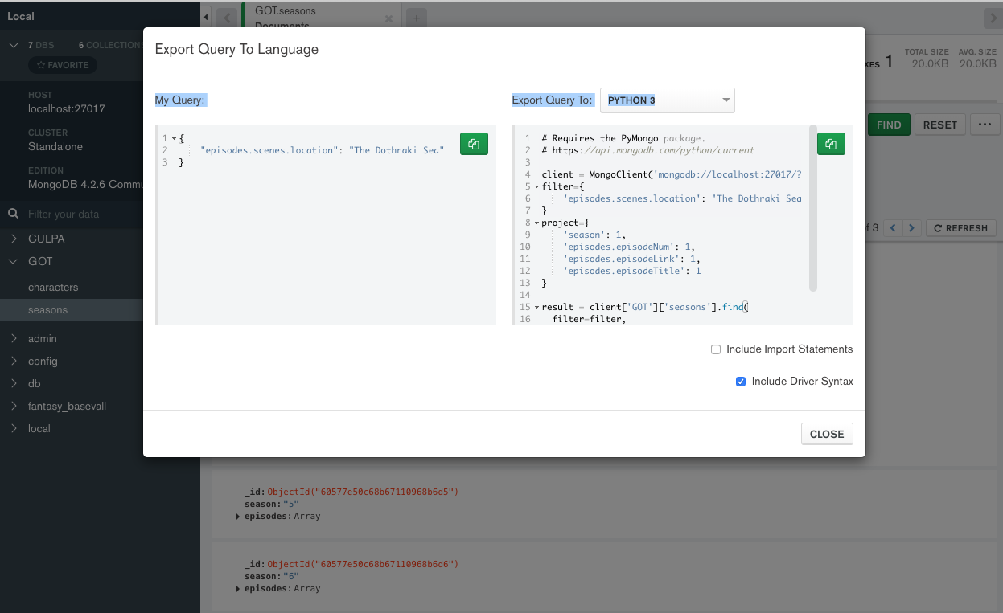
Generate Code
Choose Export to Language.
Copy into the notebook.
The export has an option to include all the connection setup, choosing DB, ... ...
Switch to Notebook

Slide 76
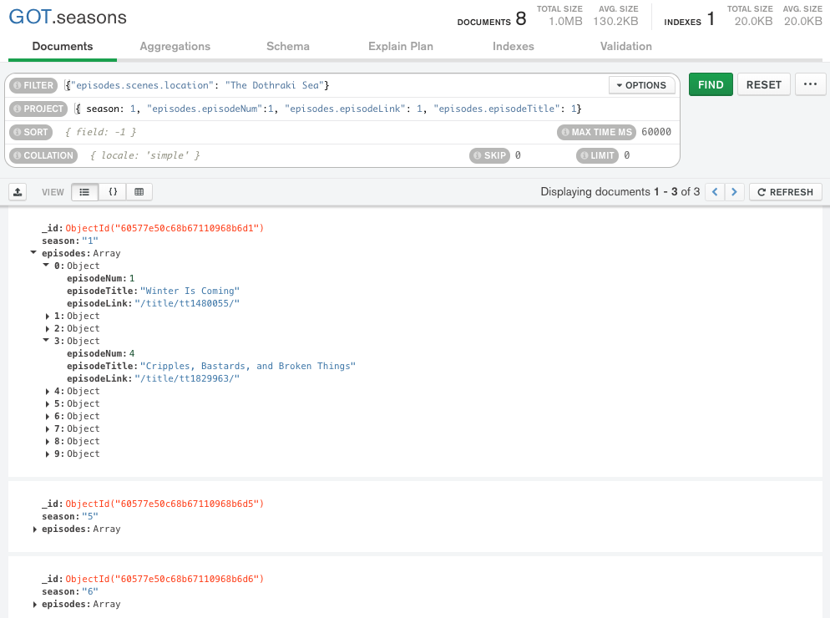
Result is not Quite You Expect
The query returns documents that match.
The document is “Large” and has and episodes and seasons.
If you do a $project requesting episodes/episode content,
You get all episodes in the documents that match.
Not just the episodes with the scene/location.
Projecting array elements from arrays whose elements are arrays is complex and baffling.
You also get back something (a cursor) that is iterable.

Slide 77
Result is not Quite You Expect
The query returns documents that match.
The document is “Large” and has and episodes and seasons.
If you do a $project requesting episodes/episode content,
You get all episodes in the documents that match.
Not just the episodes with the scene/location.
Projecting array elements from arrays whose elements are arrays is complex and baffling.
You also get back something (a cursor) that is iterable.
Net for HWs and exams:
We will keep the queries simple.
The language is as complex as SQL, and we spent several weeks on the language.
Let’s take a look in the Jupyter Notebook on some create and insert functions.
But, first, the datamodel impedance mismatch concept.

Slide 78
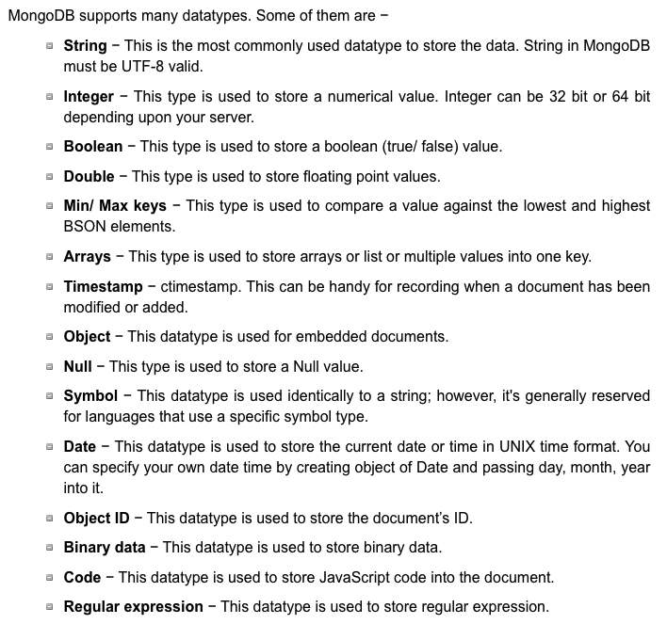
More Fun – Data Types
Python
pymysql
pymongo
SQL
MongoDB

Slide 79
(Some) MongoDB CRUD Operations
Create:
db.collection.insertOne()
db.collection.insertMany()
Retrieve:
db.collection.find()
db.collection.findOne()
db.collection.findOneAndUpdate()
... ..
Update:
db.collection.updateOne()
db.collection.updateMany()
db.collection.replaceOne()
Delete:
db.collection.deleteOne()
db.collection.deleteMany()
pymongo maps the camel case to _, e.g.
findOne()
find_one()
There are good online tutorials:
https://www.tutorialspoint.com/python_data_access
https://www.tutorialspoint.com/mongodb/index.htm

Slide 80
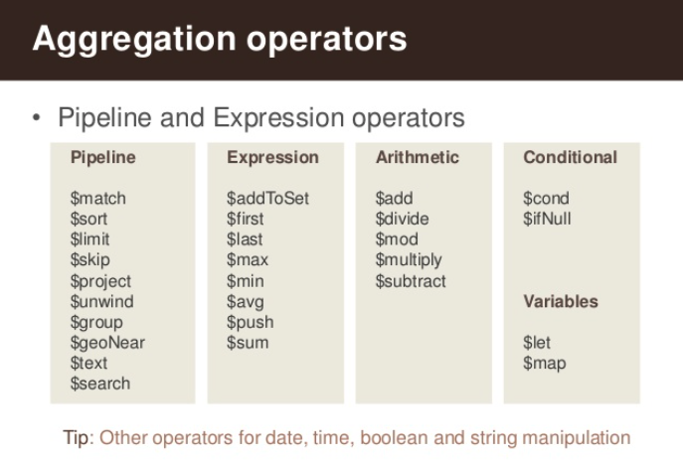
(Some) MongdoDB Pipeline Operators
https://www.slideshare.net/mongodb/s01-e04-analytics

Slide 81
MongoDB Checkpoint
You can see that MongoDB has powerful, sophisticated
Operators
Expressions
Pipelines
We have only skimmed the surface. There is a lot more:
Indexes
Replication, Sharding
Embedded Map-Reduce support
... ...
We will explore a little more in subsequent lectures, homework, ... ...
You will have to install MongoDB and Compass for HW4 and final exam.

Slide 82
NoSQL
82 | COMS W4111_002_2023_1 - Lecture 8: Module II, NoSQL, Document DBs © Donald F. Ferguson, 2023

